Slide 1
OCR AS Level Physical Education Specification H155
Links
OCR A Level Physical Education Specification H555
OCR Exam Board
AS
H155
A-Level
H555

Slide 2
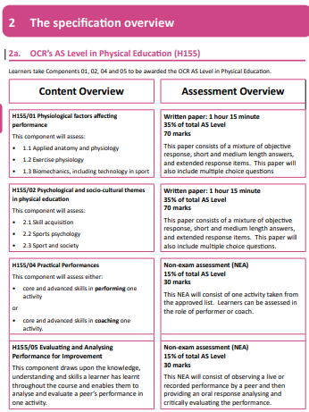
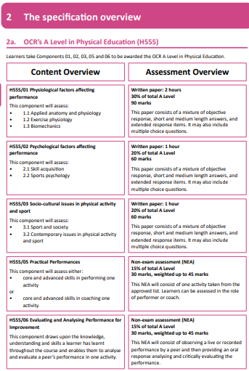
Advice is to get two folders one for each paper
AS
2 exams 35% each
EAPI 15%
Practical 15%
A-Level
1 exam 30%
2 exams 20% each
EAPI 15%
Practical 15%

Slide 3
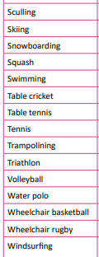
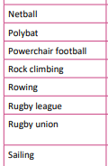
OCR AS and A Level Physical Education NEA Guide
Link
15% practical to be picked from this list

Slide 4
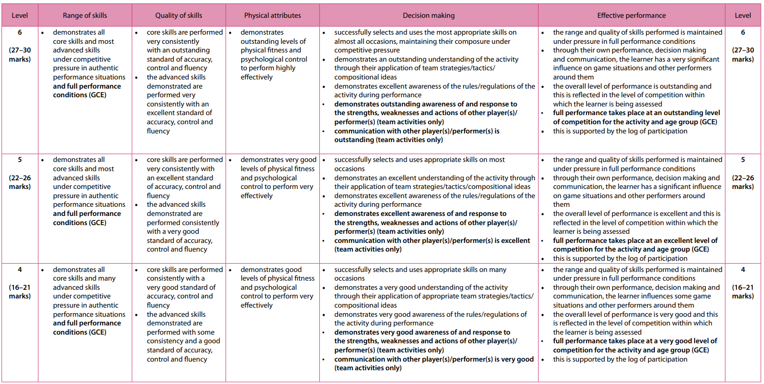
Top Half of practical assessment grid
Outstanding (national, best in country)
Excellent (Regional, 1st team Club player)
Very Good (Club Player)

Slide 5
Name –
Year 11 – Sports Course Studied? –
Grade –
Science Course Studied -
Grades –
Sport chosen for A-Level practical assessment –
Level of Participation -
Post 16 Plan –
Specific area of interest -

Slide 6
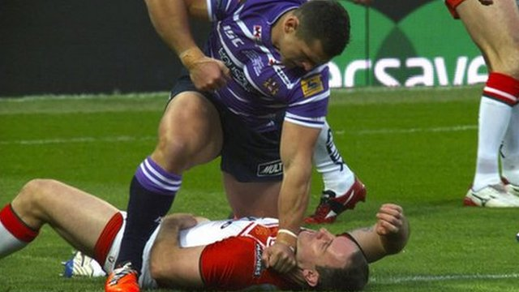
Aggression

Slide 7
Definitions
Aggression is any form of behaviour directed towards the goal of harming or injuring another living being who is motivated to avoid such treatment (Baron 1977)
Any behaviour that is intended to harm another individual by physical or verbal means.(Bull 1990)
An act with the intention to harm or injure an individual who is motivated to avoid such harm. (Baron 1994)

Slide 8
Types of Aggression
Instrumental aggression
Displaying aggressive behaviour in pursuit of a non aggressive goal
Sometimes referred to as channelled aggression (most aggression in sport is this type)
A good example would be a martial arts fighter who is intending to hurt his opponent but only because that is required if he wants to achieve the non aggressive goal of winning the fight.
They will normally shake hands after which shows that the aggression was just a tool to try and win.

Slide 9
Types of Aggression
Hostile aggression
Aggressive behaviour with the sole intention of inflicting harm (either physical or psychological) on another person.
Not used to achieve a non aggressive goal
Never within the rules of play
Sometimes referred to as reactive aggression as it can be in reaction to an incident and also accompanied by anger

Slide 10
Types of Aggression
Assertive behaviour
Different from aggressive behaviour as the individual is playing within the rules of the game.
4 criteria
Goal directed
Is not intended to harm or injure
Uses only legitimate force (even if that amount of force could be classed as aggression in non sporting contest
Does not break rules of the game

Slide 11
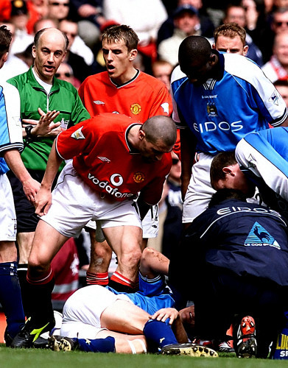
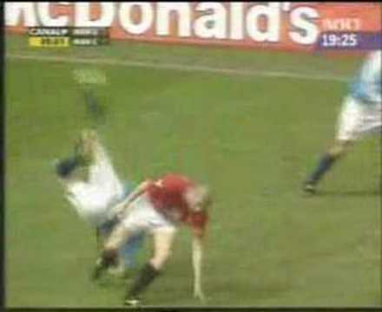
Example
Hostile Aggression
4 years later
He wrote: “I'd waited long enough. I f*cking hit him hard. The ball was there (I think). Take that you c***. And don't ever stand over me ..

Slide 12
Types of Aggression recap
Type of Aggression / Behaviour | Key Points | Real Life example

Slide 13
 | Types of aggression
Scenario | Instrumental aggression (aggressive behaviour in pursuit of non aggressive goal | Hostile aggression (Sole intention of causing harm) | Assertive behaviour (not intended to causes harm or injury uses legitimate force is within laws of game)
Manu Tuilagi Punch / Ben Flower Punch https://youtu.be/4WcvUrNuZ4U?si=XDMdVMiChAPMxFu7 | https://youtu.be/fm6hcetQycQ?si=My29k9HZUBJ4q2ZX
Hockey player pushing opponent https://youtu.be/fm6hcetQycQ?si=My29k9HZUBJ4q2ZX
Andy Murray smashing racquet https://youtu.be/Aj91nJOmj-Q?si=FyHWepCeitv84lho
American football tackles https://youtu.be/v-1MQ0Cnbhs?si=hImx2VbeC2M1FFni
Courtney Laws Tackle https://youtu.be/S3QDOWk1qIo?si=w91og-HaIZTZaAkc

Slide 14
Where would we go next???
Now that we understand what classes as aggression and what the different types of aggression are we would move onto looking at the causes of aggression.
There are 3 different theories that psychologists use to try and explain aggression.
Instinct theory
Social Learning theory
Frustration aggression theory
Aggressive cue hypothesis
You would need to be able to outline all three theories (AO1) Give sporting examples of them being used (AO2) and evaluate the strengths and weaknesses each theory (AO3)
The next slides briefly cover the four theories mentioned above. Next year we would spend a lesson on each and
complete tasks aimed at understanding the theories and importantly being able to evaluate their effectiveness when
being applied to sport. Take a look over the slides and draw your own conclusions, which theory best explains aggression?
Then attempt to answer the exam questions at the end of this document. Please bring these with you in September.

Slide 15
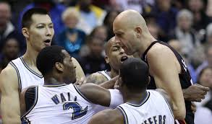
Aggression: definition and theories
1.17
Definition
of aggression
Any behaviour that is intended to harm another individual by physical or verbal means.(Bull 1990)
An act with the intention to harm or injure an individual who is motivated to avoid such harm. (Baron 1994)
Instinct theory
a trait theory proposed by Freud (1920) (Lorenz 1966)
states that aggression is inevitable as it is genetically inherited, and is therefore predictable
the aggressive trait is called the ‘death instinct’ which is behaving aggressively, even when self destructive (not in the individual’s best interests).
This is a trait view of aggression

Slide 16
Instinct theory of aggression (Lorenz 1966)
Suggests that we have a built in instinct to be aggressive that builds up until we release it by being aggressive.
This build up can be released by being aggressive towards other people.
Or it can be released in socially acceptable ways (such as sport) in a process called catharsis.
Many people seem to relate to this theory however there is very little research based evidence to back it up so few people use it as a means of explaining aggression.
If this was true then everyone would be aggressive no matter what their culture or up bringing.

Slide 17
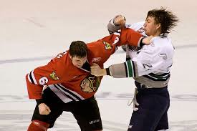
Aggression: definition and theories
1.17
Definition
of aggression
Any behaviour that is intended to harm another individual by physical or verbal means.(Bull 1990)
An act with the intention to harm or injure an individual who is motivated to avoid such harm. (Baron 1994)
Social Learning theory
proposed by Bandura (1966)
aggression is learned through imitation of others, particularly of role models
aggression is more likely to be copied if the role model is reinforced for it
aggression is more likely if it is the social norm of the group, which may link to the sport being played. Eg: American football
This is a social learning views of aggression

Slide 18
Social Learning theory of aggression (Bandura 1977)
Says that aggression is behaviour that we learn by watching others be aggressive
Its works in the same way that the social learning theory did when we spoke about in terms of personality
Someone important is aggressive
You copy them
Your actions get reinforced (positively)
You learn the aggressive behaviour
No instinct to be aggressive (disputes the instinct theory)
If we can learn to be aggressive then we can also learn to not be aggressive

Slide 19
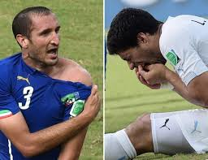
1.18
Aggression: Theories (continued)
Frustration aggression hypothesis
proposed by Dollard (1939)
this theory proposed that frustration is caused by the environment blocking the goals of the performer, which inevitably triggers aggression.
if the aggressive act is successful, frustration will be released through catharsis.
if the act is unsuccessful or is punished, then there will be a further build up of aggression.
This is an interactionist theories of aggression – they each have a trait and social learning component
Catharsis
Success
Goal blocked
Frustration
Aggression
Punishment

Slide 20
Frustration –aggression theory of aggression (Dollard et al 1939)
This theory says that aggression comes from you having your goals blocked or your progress towards your goals blocked, this is said to cause frustration which then turns into aggression
Most people can think of a time when they have been frustrated and then got aggressive so people agree with this part of the theory
However the theory states that frustration will always result in aggression and because this is simply not true the theory cannot be used to accurately explain the cause of aggression

Slide 21
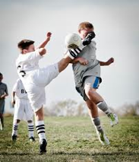
1.18
Aggression: Theories (continued)
Aggressive cue hypothesis
proposed by Berkowitz (1969)
this theory proposed that frustration leads to increased arousal which creates a readiness for aggression
aggression will only be triggered if provoked by a cue from the environment. e.g. if a player’s arousal is high and the referee makes a decision which is considered unfair, an aggressive act will follow.
This is an interactionist theories of aggression – they each have a trait and social learning component
Presence of aggressive cue
Aggression likely
Frustration
Increased arousal
Absence of aggressive cue
Aggression unlikely

Slide 22
Aggressive Cue Hypothesis (Berkowitz 1974)
When we become frustrated there is an increase in their arousal
This increase creates an predisposition (readiness) for aggression
If aggression is going to occur according to the theory certain stimuli must be present that act as cue’s
The athlete associates the cues with having to be aggressive (so is aggressive)

Slide 23
Theory | AO1 Describe | AO2 Example | AO3 Compare Contrast + / -

Slide 24
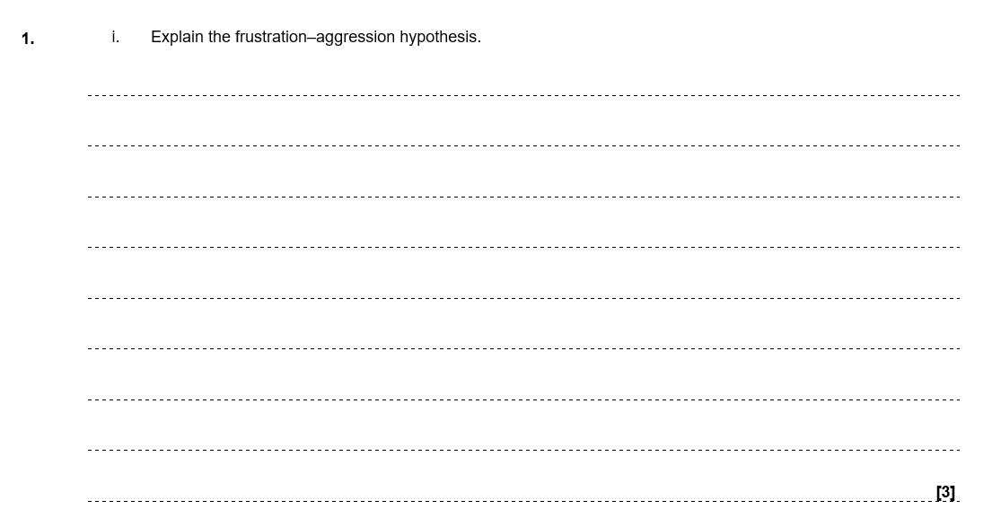

Slide 25
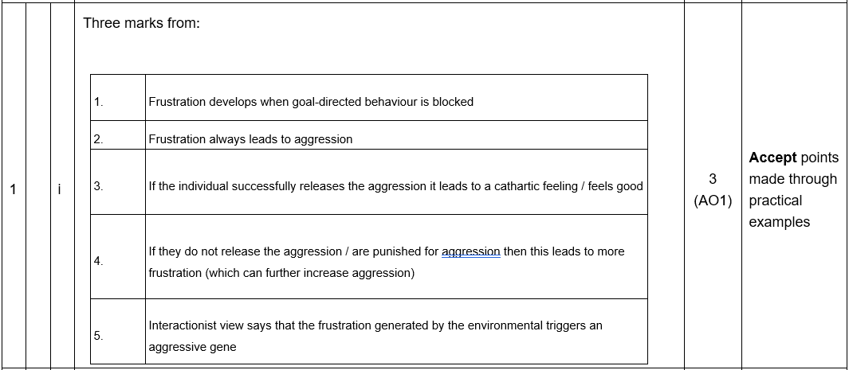

Slide 27
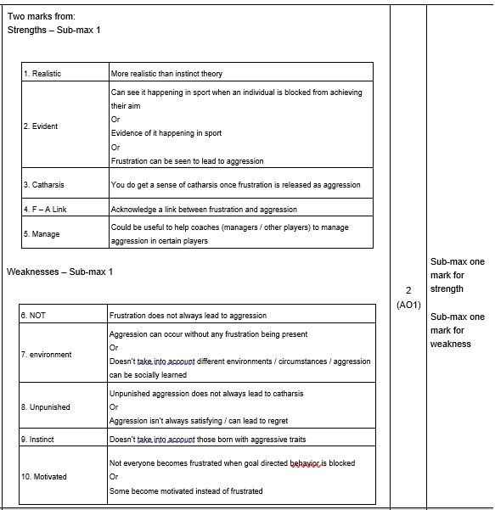

Slide 29
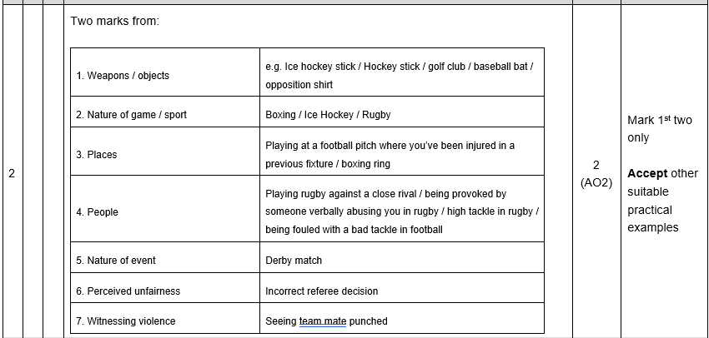

Slide 30
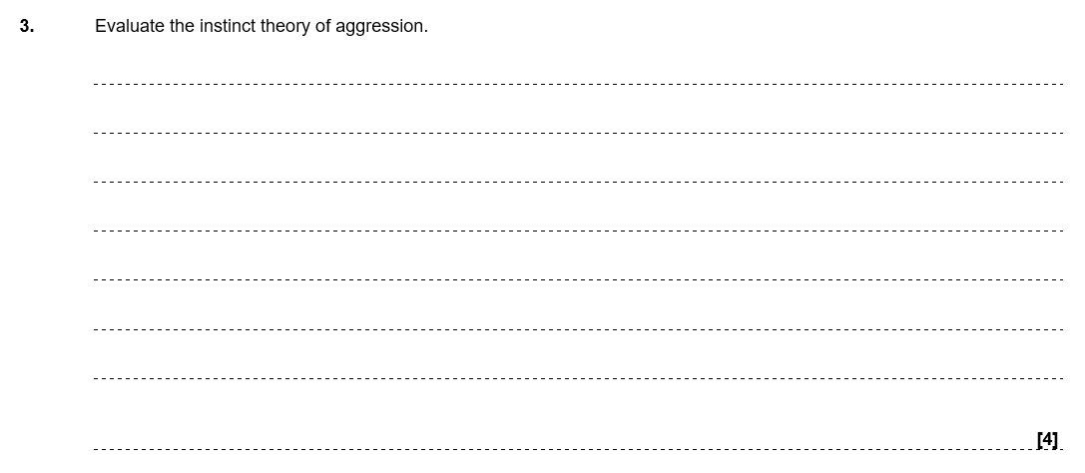

Slide 31
